Slide 1
Module 13b
Describing Moving Image Resources
RDA Training
University of Nevada, Reno
February 2013
Notes:
This module is intended to cover special procedures for audio recordings that differ from books. We’ve already covered thoroughly how to describe a book. We won’t go over all that again, exept to note when you do the same thing for an audio recording.

Slide 2
Title
Transcribe the title proper, parallel title proper and other title information exactly as found on the preferred source.
However, see 2.3.1.6: Do not transcribe words that serve as an introduction and are not intended to be part of the title.
Notes:
Read together 2.3.1.6.

Slide 3



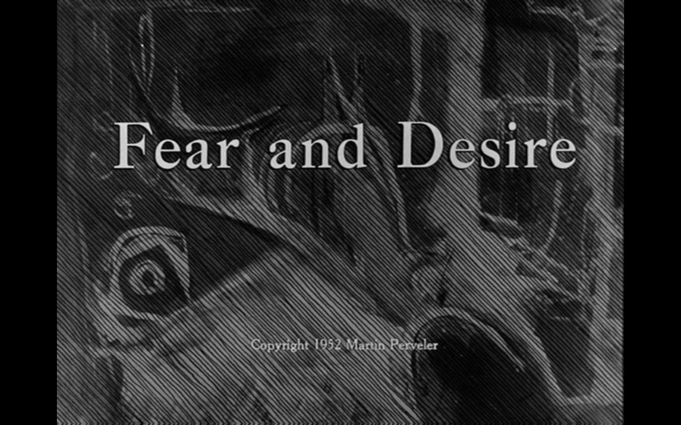
What’s the Title?

Slide 4
Title
245 00 $a Fear and desire

Slide 5
Title
2.3.2.9. Resource lacking a collective title
  Record titles as they appear in the source of information “for the resource as a whole”
  If there isn’t such a source, treat information identifying parts as a collective source of information, and record them in the order in which they appear.
Notes:
DVDs frequently have more than one work on them. What do you do? Read together 2.3.2.9.

Slide 6
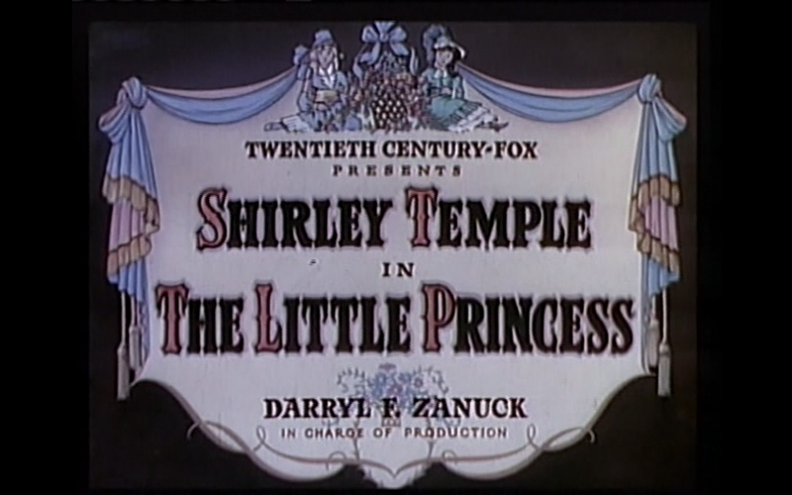


Title?

Slide 7
Title
245 04 $a The little princess ; $b Shirley Temple festival

Slide 8
Statement of Responsibility
Same as for other formats except
  Statements identifying performers of music (7.23)
  Statements identifying narrators, presenters, other kinds of performers (e.g. actors) (7.23)
  Statements identifying contributors to the artistic and/or technical production (7.24)
These statements are recorded as notes (511 or 508 field)
Notes:
Read together 2.4.1.1, exceptions for performers and narrators--click through to 7.23.

Slide 9
Statement of Responsibility
245 00 $a Fear and desire / $c written by Howard Sackler ; produced by Stanley Kubrick ; associate producer, Martin Perveler.
245 04 $a The little princess ; $b Shirley Temple festival.
Notes:
Look through the title frames to decide what to include.
This is a bit of a grey area. Producers and prominently named screenwriters are usually included in statements of responsibility for films, even though they might be “artistic or technical credits”. Writers of the music are not recorded here, they are recorded in an artistic/technical credits note.
In the case of Shirley Temple, there isn’t really a statement of responsibility that applies to the resource as a whole; we could include SoRs for each part, but since the second part is itself a collective title for several short films, perhaps better not to record any SofR here.

Slide 10
Variant titles
Record in 246
245 04 $a The little princess ; $b Shirley Temple festival.
246 3 $a Shirley Temple festival
Notes:
See MARC 246 if you need a coding reminder.
Variant titles are not core. Record them if you think they would help lead the user to the resource.

Slide 11
Edition Statement
Transcribe any edition statement you find.
245 00 $a Victor Borge classic collection.
250 $a 100th anniversary edition.

Slide 12
Publication Statement
Record publication information as you find it.
Note: The production company is not usually the publisher of the manifestation you are describing.
The production company is also not a producer in the sense of RDA 2.7 (Production statement)
Production company is recorded in a note.
Notes:
The RDA production statement is used to record information about unpublished resources.
Place of publication is often omitted in resources, so you may have to search to find out where the publisher was located. Also be careful to distinguish publishers from distributors. Imdb.com is an excellent source.

Slide 13
Publication Statement
245 00 $a Fear and desire / $c written by Howard Sackler ; produced by Stanley Kubrick ; associate producer, Martin Perveler.
264 _1 $a New York, New York : $b Kino Classics ; $a [Washington, D.C.] : $b Library of Congress, $c [2012]
245 04 $a The little princess ; $b Shirley Temple festival.
264 _1 $a New York, N.Y. : $b GoodTimes Entertainment Limited, $c [2002]
Notes:
The RDA production statement is used to record information about unpublished resources.
Place of publication is often omitted in resources, so you may have to search to find out where the publisher was located. Also be careful to distinguish publishers from distributors. Imdb.com is an excellent source.

Slide 14
Copyright information
Optionally, record copyright information
245 04 $a The little princess ; $b Shirley Temple festival.
264 _1 $a New York, N.Y. : $b GoodTimes Entertainment Limited, $c [2002]
264 _4 $c ©2002

Slide 15
Distribution information
Optionally record distribution information
  264 _2 $b Universal Music & Video Distribution
    Source reads: Distributed by Universal Music & Video Distribution; no place given.
Notes:
You don’t need to record a place, in fact you don’t need to record any of it--none of it is core unless publication information has not been identified.

Slide 16
Manufacture information
Optionally record manufacture information
  264 _3 $b Universal Music Classics Group
    Source reads: Manufactured and marketed by Universal Music Classics Group; no place given.

Slide 17
Extent (3.4.1)
Record the number of units with an video or projected image term from the carrier type list in 3.3.1.3
  300 $a 1 videodisc
  300 $a 3 film reels
Alternatively, use a term in common usage if your agency prefers it
  300 $a 2 DVDs
Notes:
Go to 3.3.1.3

Slide 18
Duration (7.22)
Record the duration in parentheses following the extent if it can be determined. Abbreviate “hr.” “min.” “sec.”
      245 04 $a The little princess ; $b Shirley Temple festival.
      300 $a 1 videodisc (147 min.)
      245 00 $a Fear and desire / $c written by Howard Sackler ; produced by Stanley Kubrick ; associate producer, Martin Perveler.
      300 $a 1 videodisc (88 min.)
Notes:
7.22. Note this is an attribute of the expression, not the manifestation. The duration of Shirley Temple is given on the box. The duration of Kubrik is also given on the box, but I added the length of Fear and Desire to a “special feature” included with the film to arrive at 88 min. for the total duration of the DVD.

Slide 19
Sound content (7.18)
Record “sound” or “silent” in 300 $b
245 04 $a The little princess ; $b Shirley Temple festival.
300 $a 1 videodisc (147 min.) : $b sound
245 00 $a Fear and desire / $c written by Howard Sackler ; produced by Stanley Kubrick ; associate producer, Martin Perveler.
300 $a 1 videodisc (88 min.) : $b sound

Slide 20
Color content (7.17.3)
Record “color” and/or “black and white” in 300 $b
245 04 $a The little princess ; $b Shirley Temple festival.
300 $a 1 videodisc (147 min.) : $b sound, color and black and white
245 00 $a Fear and desire / $c written by Howard Sackler ; produced by Stanley Kubrick ; associate producer, Martin Perveler.
300 $a 1 videodisc (88 min.) : $b sound, black and white
Notes:
Note: on this one I only recorded color content for the main film(s). In the Shirley Temple example, the films are all of more or less equal weight, but Fear and desire also has a “bonus” film, not mentioned in the title, that is in color.

Slide 21
Dimensions (3.5)
Record dimensions according to the appropriate format in 3.5.1.4
  Discs: record diameter (LC records in inches)
        DVD or MP3
    300 ... ; $c 4 3/4 in. or 12 cm
        Laserdisc
    300 ... ; $c 12 in. or 30 cm
  Cassettes: record the gauge (width) of the tape (LC records in metric)
    Videocassette
    300 ... ; $c 13 mm
Notes:
Everyone open to 3.5.1.4. The preferred unit of measure is metric, but alternatively the cataloging agency can choose another unit of measure. For discs, LC has chosen to measure in inches. Note this is abbreviated.

Slide 22
Dimensions (3.5)
245 04 $a The little princess ; $b Shirley Temple festival.
300 $a 1 videodisc (147 min.) : $b sound, color or black and white ; $c 4 3/4 in.
245 00 $a Fear and desire / $c written by Howard Sackler ; produced by Stanley Kubrick ; associate producer, Martin Perveler.
300 $a 1 videodisc (88 min.) : $b sound, black and white or color ; $c 4 3/4 in.
Notes:
Everyone open to 3.5.1.4. The preferred unit of measure is metric, but alternatively the cataloging agency can choose another unit of measure. For discs, LC has chosen to measure in inches. Note this is abbreviated.

Slide 23
Record content, media, and carrier type (3.2, 3.3, 6.9)
336 $a two-dimensional moving image $2 rdacontent
337 $a video $2 rdamedia
338 $a videodisc $2 rdacarrier
Notes:
This is the most common combination, but Record content type as appropriate--might also be, for example, performed music.

Slide 24
Sound Characteristic (3.16)
Record in 344 field
  type of recording in $a
    344 $a digital
    344 $a analog
  recording medium in $b
    344 $b magnetic [for tapes]
    344 $b magneto-optical
    344 $b optical [for digital discs]
Notes:
Note: this information used to be recorded in 300 subfield $b.

Slide 25
Sound Characteristic (3.16)
Record in 344 field
  playback configuration in $g
    344 $g mono
    344 $g stereo
    344 $g quadraphonic
    344 $g surround
  special playback characteristics $h
    344 $h dbx encoded
    344 $h Dolby
Notes:
There are other sound characteristics but these are the most commonly recorded.

Slide 26
Sound Characteristic (3.16)
End the 344 field with $2 rda if you’ve used the vocabulary prescribed by RDA.
245 04 $a The little princess ; $b Shirley Temple festival.
344 $a digital $b optical $g mono $h Dolby $2 rda
245 00 $a Fear and desire / $c written by Howard Sackler ; produced by Stanley Kubrick ; associate producer, Martin Perveler.
344 $a digital $b optical $2 rda
Notes:
This information all comes from the container of this disc. The other disc doesn’t have any information. We can infer that it’s digital and optical from its format. Given the date of the films (1953) we might have been able to guess “mono” but I decided not to.

Slide 27
Video Characteristic (3.18)
Technical specification relating to the encoding of video images in a resource.
Record in 346
  Video format $a
    346 $a Beta
    346 $a VHS
  Broadcast standard $b
    346 $b HDTV
    346 $b NTSC
Notes:
Look together at 3.18

Slide 28
Video Characteristic (3.18)
End the 346 field with $2 rda if you’ve used the vocabulary prescribed by RDA.
245 04 $a The little princess ; $b Shirley Temple festival.
346 $b NTSC $2 rda
245 00 $a Fear and desire / $c written by Howard Sackler ; produced by Stanley Kubrick ; associate producer, Martin Perveler.
346 $b NTSC $2 rda
Notes:
In both of these cases this information was on the container.

Slide 29
Digital File Characteristic (3.19)
Record in 347
  File type in $a
    347 $a video file
  Encoding format in $b
    347 $b Blu-ray
    347 $b DVD video
    347 $b QuickTime
Notes:
Everyone look at 3.19.

Slide 30


Digital File Characteristic (3.19)
Record in 347
  Regional encoding in $e
    347 $e region 1
    347 $e all regions
Symbols you may find on DVD containers:
Notes:
Everyone look at 3.19.

Slide 31
Digital File Characteristic (3.19)
End the 347 field with $2 rda if you’ve used the vocabulary prescribed by RDA.
245 04 $a The little princess ; $b Shirley Temple festival.
347 $a video file $b DVD video $e all regions $2 rda
245 00 $a Fear and desire / $c written by Howard Sackler ; produced by Stanley Kubrick ; associate producer, Martin Perveler.
347 $a video file $b DVD video $e region 1 $2 rda
Notes:
Everyone look at 3.19.

Slide 32
Series Statement
Record series statement if present on the item (no different from any other format)

Slide 33
Notes
Record notes as appropriate.
  Intended audience (RDA 7.7, MARC 521)
    521 8_ $a Not rated
    521 8_ $a MPAA rating: PG-13
  summary of content (RDA 7.10, MARC 520)
    520 $a A plane carrying four soldiers crashes in a forest behind enemy lines in an unnamed country. Desperate to escape, the group plans to build a raft and travel up the river into allied country. However, they are sidetracked by a local woman who stumbles across them in the woods, and the nearby presence of an enemy general who one member of the group is determined to kill.
Notes:
Read RDA 7.7

Slide 34
Notes
Record notes as appropriate.
  Contents (RDA chapter 25, MARC 505)
    505 0_ $a The little princess / Twentieth Century-Fox ; Darryl F. Zanuck, in charge of production ; directed by Walter Lang ; screen play by Ethel Hill and Walter Ferris -- Shirley Temple festival: War babies / released by Comedy House -- Kid in Africa / directed by Jack Hays -- Dora's dunking doughnuts / directed by Harry J. Edwards ; story and dialogue, Ernest Pagano, Edwart Adamson -- Pardon my pups / directed by Charles Lamont.
  Place and date of capture (RDA, 7.11, MARC 518)
    518 $a Filmed on location in Rome and Venice from January through June 1976.
Notes:
Look through the title frames here.

Slide 35
Notes
Record notes as appropriate.
  Language of the content (including dubbing and subtitles) (RDA 7.12, 7.14, MARC 546)
    546 $a In Spanish with optional English subtitles.
  Accessibility content (RDA 7.14, MARC 500 or 546)
    500 $a Closed captioning.
    546 $a Closed captioning in German.
  Awards
    586 $a 2012 Academy Awards for Best Achievement in Art Direction.

Slide 36
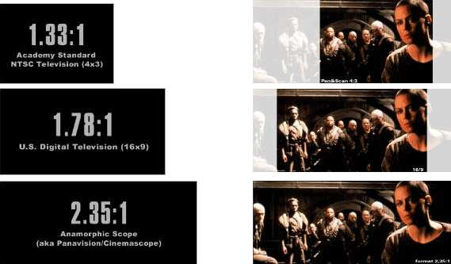
Notes: Aspect ratio (7.19)
Aspect ratio = the ratio of the width to the height of a moving image
Look for a ratio on the container
credit: onvideos.wordpress.com
Notes:
Turn to 7.19.
You might see something like this (from http://onvideos.wordpress.com/)

Slide 37
Notes: Aspect ratio (7.19)
  Record in MARC 500:
    full screen (if the ratio is less than 1.5:1)
    wide screen (if the ratio is 1.5:1 or greater)
    mixed (if there are multiple aspect ratios in same work)
  Add, in parentheses, the the ratio with the denominator (the figure after the colon) of 1, if the ratio is known

Slide 38
Notes: Aspect ratio (7.19)
245 04 $a The little princess ; $b Shirley Temple festival.
538 $a Full screen (1.33:1)
245 00 $a Fear and desire / $c written by Howard Sackler ; produced by Stanley Kubrick ; associate producer, Martin Perveler.
538 $a Full screen (1.33:1)

Slide 39
Notes:
Performer, Narrator, Presenter (7.23)
Record in 511.
List the names as concisely as possible, together with information about what each did.
245 04 $a The little princess ; $b Shirley Temple festival.
511 1_ $a The little princess: Shirley Temple, Richard Greene, Anita Louise, Ian Hunter, Cesar Romero, Arthur Treacher.
245 00 $a Fear and desire / $c written by Howard Sackler ; produced by Stanley Kubrick ; associate producer, Martin Perveler.
511 1_ $a Frank Silvera, Paul Mazursky, Kenneth Harp, Stephen Coit, Virginia Leith.
Notes:
First indicator 1 = cast.

Slide 40
Notes:
Artistic or Technical Credit (7.24)
Record in 508.
List the names as concisely as possible, together with information about what each did.
245 04 $a The little princess ; $b Shirley Temple festival.
508 $a The little princess: photography by Arthur Miller, William Skall ; film editor, Louis Loeffler. Shirley Temple festival: photography, Dwight Warren.
245 00 $a Fear and desire / $c written by Howard Sackler ; produced by Stanley Kubrick ; associate producer, Martin Perveler.
508 $a Photographer and editor, Stanley Kubrick.

Slide 41
Identifier for the manifestation (2.15)
Record identifiers
  ISBN in 020
  Publisher number in 028 42
020 $a 0766210448
028 42 $a 05-81357 $b GoodTimes DVD
245 04 $a The little princess ; $b Shirley Temple festival.
028 42 $a K959 $b Kino Classics
245 00 $a Fear and desire / $c written by Howard Sackler ; produced by Stanley Kubrick ; associate producer, Martin Perveler.

Slide 42
Record Relationships
Record the principal creator (core), if any. Most motion pictures do not have one, though.
6.27.1.3 says to construct the authorized access point for a collaborative motion image work using the preferred title alone (i.e., no principal creator).
Notes:
Read together 6.27.1.3

Slide 43
Record Relationships
Record the relationship of the resource to the work embodied in it.
Single work
  130 0_ $a Planet of the apes (Motion picture : 2001)
  245 10 $a Planet of the apes / $c Twentieth Century Fox presents a Zanuck Company production ; a Tim Burton film ; produced by Richard D. Zanuck ; screenplay by William Broyles, Jr. and Lawrence Konner & Mark Rosenthal ; directed by Tim Burton.
Notes:
Reminder: this is done by embedding the authorized access point for the work in the record. The authorized access point for Planet of the apes has a qualifier because there are more than one film with the same title.

Slide 44
Record Relationships
Record the relationship of the resource to the work embodied in it.
More than one work in resource
  245 04 $a The little princess ; $b Shirley Temple festival.
  730 02 $a Little princess (Motion picture : 1939)
  730 02 $a War babies (Motion picture)
  730 02 $a Kid in Africa (Motion picture)
  730 02 $a Dora’s dunking doughnuts (Motion picture)
  730 02 $a Pardon my pups (Motion picture)
Notes:
Reminder: More than one work in the resource.

Slide 45
Record Relationships
Record the relationship of the resource to the work embodied in it.
More than one work in resource
  245 00 $a Fear and desire / $c written by Howard Sackler ; produced by Stanley Kubrick ; associate producer, Martin Perveler.
  730 02 $a Fear and desire (Motion picture)
  730 02 $a Seafarers (Motion picture)
Notes:
Reminder: More than one work in the resource.

Slide 46
Record Relationships
Record other relationships you consider important.
245 04 $a The little princess ; $b Shirley Temple festival.
700 1_ $a Zanuck, Darryl Francis, $d 1902-1979, $e film producer.
700 1_ $a Lang, Walter, $d 1898-1972, $e film director.
700 1_ $a Hill, Ethel, $d 1898-1954, $e screenwriter
700 1_ $a Ferris, Walter, $d 1882-1965, $e screenwriter.
700 1_ $a Temple, Shirley, $d 1928- $e performer.
700 1_ $i Motion picture adaptation of (work): $a Burnett, Frances Hodgson, $d 1849-1924. $t Little princess.
Notes:
These are just a few possibilities. Others could be included.

Slide 47
Record Relationships
Record other relationships you consider important.
245 00 $a Fear and desire / $c written by Howard Sackler ; produced by Stanley Kubrick ; associate producer, Martin Perveler.
700 1_ $a Kubrick, Stanley, $e film producer.
700 1_ $a Sackler, Howard, $e screenwriter.
700 1_ $a Silvera, Frank, $d 1914-1970, $e performer.
700 1_ $a Mazursky, Paul, $e performer.
700 1_ $a Harp, Kenneth, $e performer.
700 1_ $a Coit, Stephen, $e performer.
700 1_ $a Leith, Virginia, $d 1932- $e performer.
710 2_ $a Kino Classics (Firm), $e publisher.
Notes:
These are just a few possibilities. Others could be included.

Slide 48
Exercise
Work together to catalog moving image resources workshop participants have brought, if any.

Slide 49
Module 13
Describing Moving Image Resources
Questions?
RDA Training
University of Nevada, Reno
February 2013

Slide 50
This Presentation is available at
http://net.lib.byu.edu/~catalog/people/rlm/RDAReno201302/index.htm
For further information
contact Robert L. Maxwell
robert_maxwell@byu.edu

